Slide 1
Using Bayesian Belief Networks in Assessing Software Architectures
Jilles van Gurp &
Jan Bosch

Slide 2
Contents
Qualitative Knowledge in SD
SAABNet
Validation results

Slide 3
Software Development
no quantitative information early in the design process
requirements spec.
design
greater role of metrics in assessment
implementation
test
deployment

Slide 4
But
Defect fixing becomes more expensive later in the development process
So there is a need to do assessments early on
There is not enough quantitative information available to use existing techniques

Slide 5
Qualitative Knowledge
Examples
  expert knowledge
  general statistical knowledge
  design/architecture patterns
Informal
Badly documented

Slide 6
How to use Qualitative Knowledge
Assign expert designers to team
Do peer reviews of requirement specs. and designs
Try to document the knowledge
Use AI

Slide 7
Bayesian Belief Networks
Model probabilistic distributions using information about dependencies between the variables
Are an excellent way to model uncertain causal relations between variables
SAABNet (Software Architecture Assessment Belief Network)

Slide 8
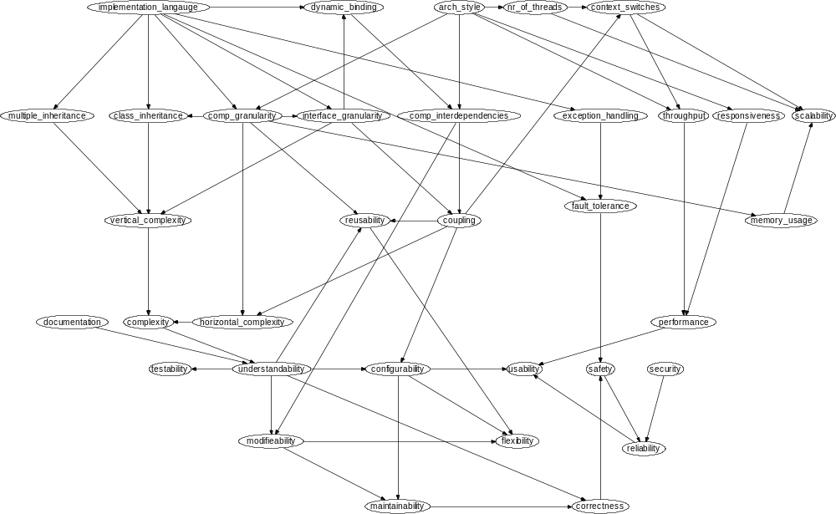
SAABNet

Slide 9
Three types of variables
Architecture Attributes
  programming language, inheritance
Quality Criteria
  complexity, coupling
Quality Factors
  maintenance, performance
More abstract

Slide 10
Usage
Insert what you know
Let the BBN calculate probabilities for what you don’t know

Slide 11
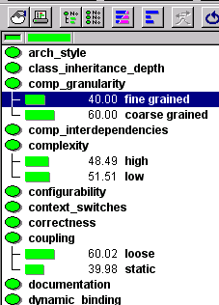
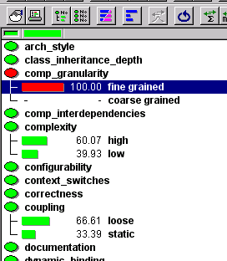
Usage (2)
The screenshots were taken from a tool called Hugin professional which is a modeling tool used for creating and testing BBNs. See www.hugin.com.

Slide 12
Validation
An embedded system
  Evaluation of existing architecture
  Impact of suggested changes in the architecture
Epoc 32
  Evaluation of Design
  Impact of QRs on Architecture

Slide 13
Our findings
We can explain SAABNets output (i.e. it doesn’t produce non sense)
Given the limited input, the output is remarkably realistic

Slide 14
Future work
Extend SAABNet to include more variables
Build a more friendly GUI around SAABNet
Do an experiment to verify whether a SAABNet based tool can help designers

Slide 15
Conclusions
BBNs provide a way to reason with qualitative knowledge in SD
Our validation shows that even with a small amount of variables the output can be useful
More validation is needed.

Slide 16
Contact information
Jilles van Gurp
http://www.ipd.hk-r.se/jvg
jvg@ipd.hk-r.se
Jan Bosch
http://www.ipd.hk-r.se/jbo
jbo@ipd.hk-r.se
Högskolan Karlskrona/Ronneby
Department of Software Engineering & Computer Science

